Slide 1
Unit 3
Letcure 3

Slide 2
Color image Processing
Importance of color: very powerful descriptor
Simplifies object identification and extraction from an image
Humans can identify thousands of colour shades and intensities
Two major areas:
Full color: acquired with a full color sensor
Pseudocolor: assign the color to a monochrome image

Slide 3
Fundamental concepts
When a beam of sunlight is passed through a prism the emerging beam is not white but consists of a range of colours
Characterization of light
Light can be achromatic or chromatic
Three basic quantities used to characterize chromatic light are
Radiance : total energy that flows from the light source
Luminance: amount of energy the observer perceives from the light source
Brightness: impossible to measure
Cones responsible for the color vision of the eyes.
About 6 to 7 million cones
65%(sensitive to red light)33%(green) 2%(blue)

Slide 4
Due to this sensitivity we have the concept of primary and secondary colors

Slide 5
Characterization

Slide 6
Color Models

Slide 7
RGB Model
0,0,0 represents black
1,1,1 represents white
Line from black to white represents the gray scale axis

Slide 8
Given any point in the RGB color plane RGB color cube represents
2²⁴ different colors
All color monitors do not have the
Capacity to display these many
Colors
Given a variety of systems today
We have a subset of colors which
Can be displayed safely
Safe RGB color : 216 colors

Slide 9
Displaying color in RGB model

Slide 10
Any color image will have one color component for red, green and blue

Slide 11
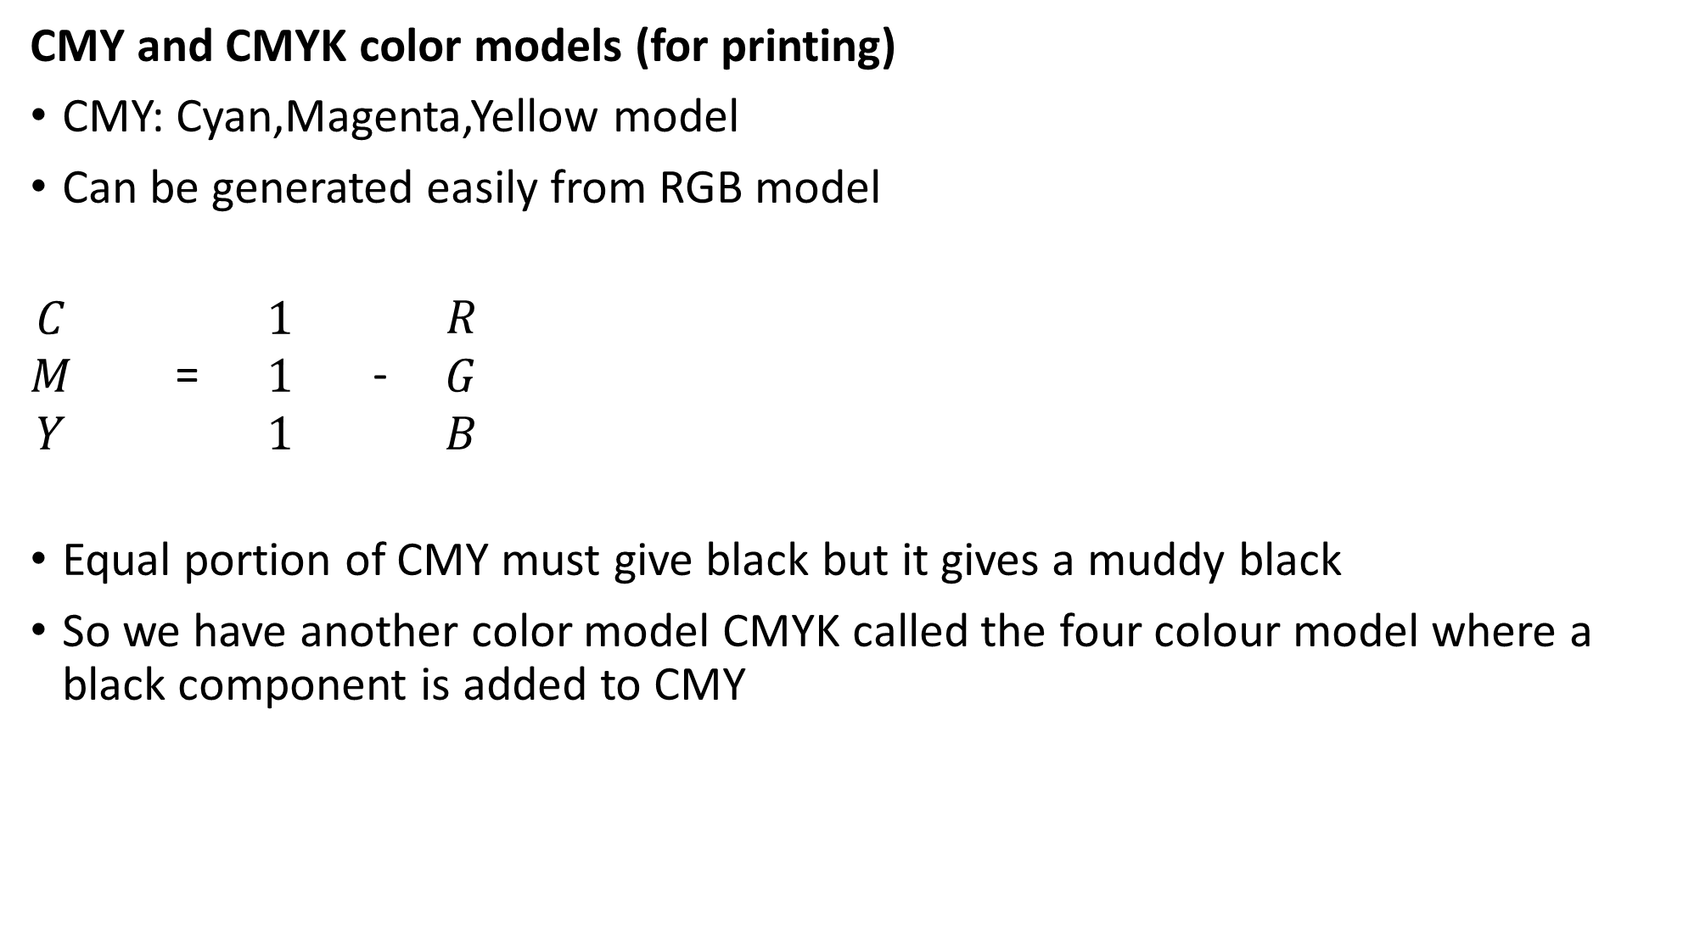



CMY and CMYK color models (for printing)
CMY: Cyan,Magenta,Yellow model
Can be generated easily from RGB model
$\begin{matrix}C \\ M \\ Y\end{matrix}$ = $\begin{matrix}1 \\ 1 \\ 1\end{matrix}$ - $\begin{matrix}R \\ G \\ B\end{matrix}$
Equal portion of CMY must give black but it gives a muddy black
So we have another color model CMYK called the four colour model where a black component is added to CMY
Conversion from RGB to CMY model

Slide 12
HSI color model
Humans perceive color in this model
Hue : specifies the prominent primary colors
Saturation: How much white light is added?
Intensity :intensity measurement
Model represents information of color as well as intensity

Slide 13
RGB and HSI relation
We can find this relation by reorienting the RGB
Cube.
Intensity
Line joining black and white is the Gray axis
Intensity of any color point can be found easily
as the point can be considered as a projection
to the intensity plane.
Pass a plane perpendicular to the intensity axis
and the color point
Intersection of the plane with the intensity axis will give the intensity of the color point considered.

Slide 14
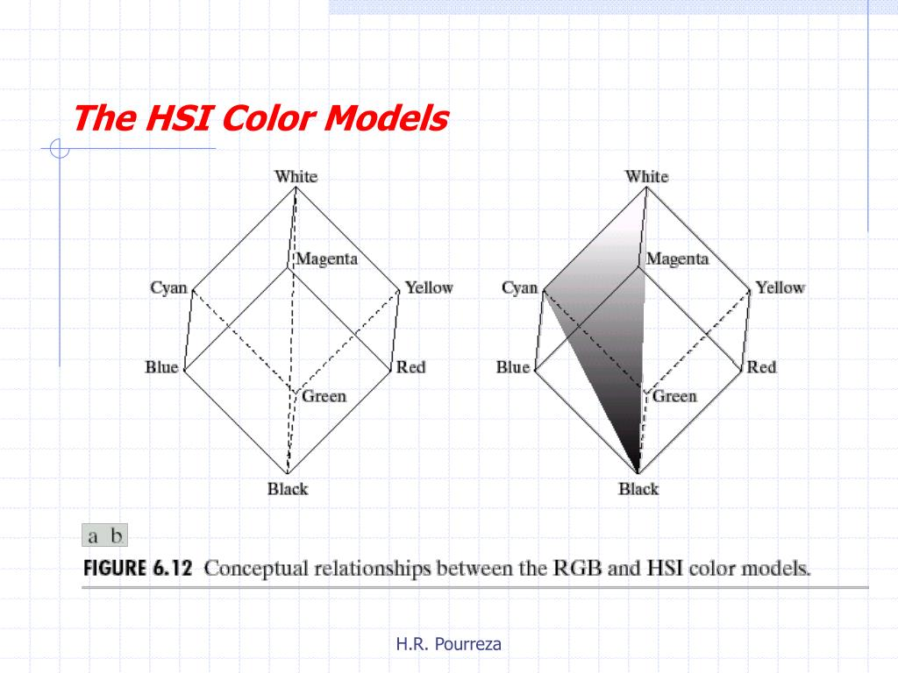
Saturation
Saturation associated with all the points in the grey level axis is 0
Saturation increases as we move away from the axis
Distance of the color point considered from the intensity axis will give the saturation at that point

Slide 15
Hue
Consider a plane defined by the three points black,white and cyan
All points in the contained plane will have the same hue
Also all colors generated by the three colors(black,white and cyan) will lie in the triangle defined by the three colors
Rotating the plane along the vertical axis will give a
different hue
So the Hue,saturation and intensity values can
be obtained from the RGB color cube.
That means we can convert any RGB point to an HSI
point using the appropriate Geometric formulas.

Slide 16
Conversion from RGB to HSI

Slide 17
Conversion from HSI to RGB

Slide 18
Question
Sketch the RGB components of the following image as they would appear on a monochrome monitor. All colors are at maximum intensity and saturation, consider the gray region as part of the image

Slide 19
Maximum intensity means 0 or 1
Create the following table with 0 representing black and 255 representing white

Slide 21
Question
Sketch the HSI components of the following image as they would appear on a monochrome monitor.

Slide 22
When R=G=B Hue is undefined since theta= cos⁻¹(0/0) =0
Saturation is undefined 1-(3/0)*0

